Slide 1
McKibben Snake Robots: Final Project Presentation
Jennifer Yang
Liv Dawes, Farhan Rozaidi, Dr. Ross L. Hatton

Slide 2
Goal
Refine a soft snake robot that can:
Perform sidewinding motion
Provide data for later validation of simulation models

Slide 3
REU Progress
Identified and verified a control scheme for sidewinding motion
Tested effects of snake skin material and terrain on movement
Qualitatively tested forward motion
Started working on a smaller snake

Slide 4
Timeline
 | Week
Task | 1 | 2 | 3 | 4 | 5 | 6 | 7 | 8 | 9 | 10
Preliminary Research
Flow Control Research
Flow Control Design
MATLAB Onboarding
Flow Control and Airline Testing
Control Scheme Testing
Material and Terrain Testing
Forward Movement Testing
Small Snake Testing
Final Presentation
Notes:
MATLAB onboarding course while virtual to get familiar with the kinematics
Identified a flow rate and airline setup for testing
Identified and verified a control scheme for sidewinding motion
Tested effects of snake skin material and terrain on movement
Qualitatively tested forward motion
Started working on a smaller snake

Slide 5
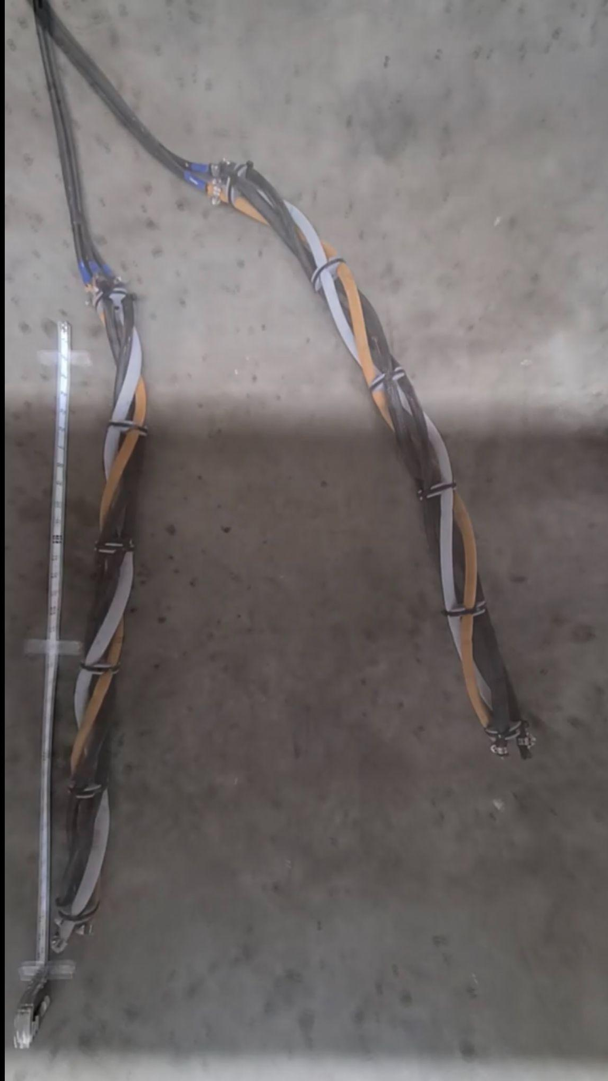
Data Collection
Quantitative Metrics
Snake head displacement (green)
Snake tail displacement (blue)
Ratio of snake tail to head displacement
Criteria
Larger displacements were better
Ratio values closer to 1 were straighter and better

Slide 6
Data Collection Reliability Issue
Airline positioning affected the snake movement
The same tests performed on different days yielded different displacements
Could only compare one days data with itself

Slide 7
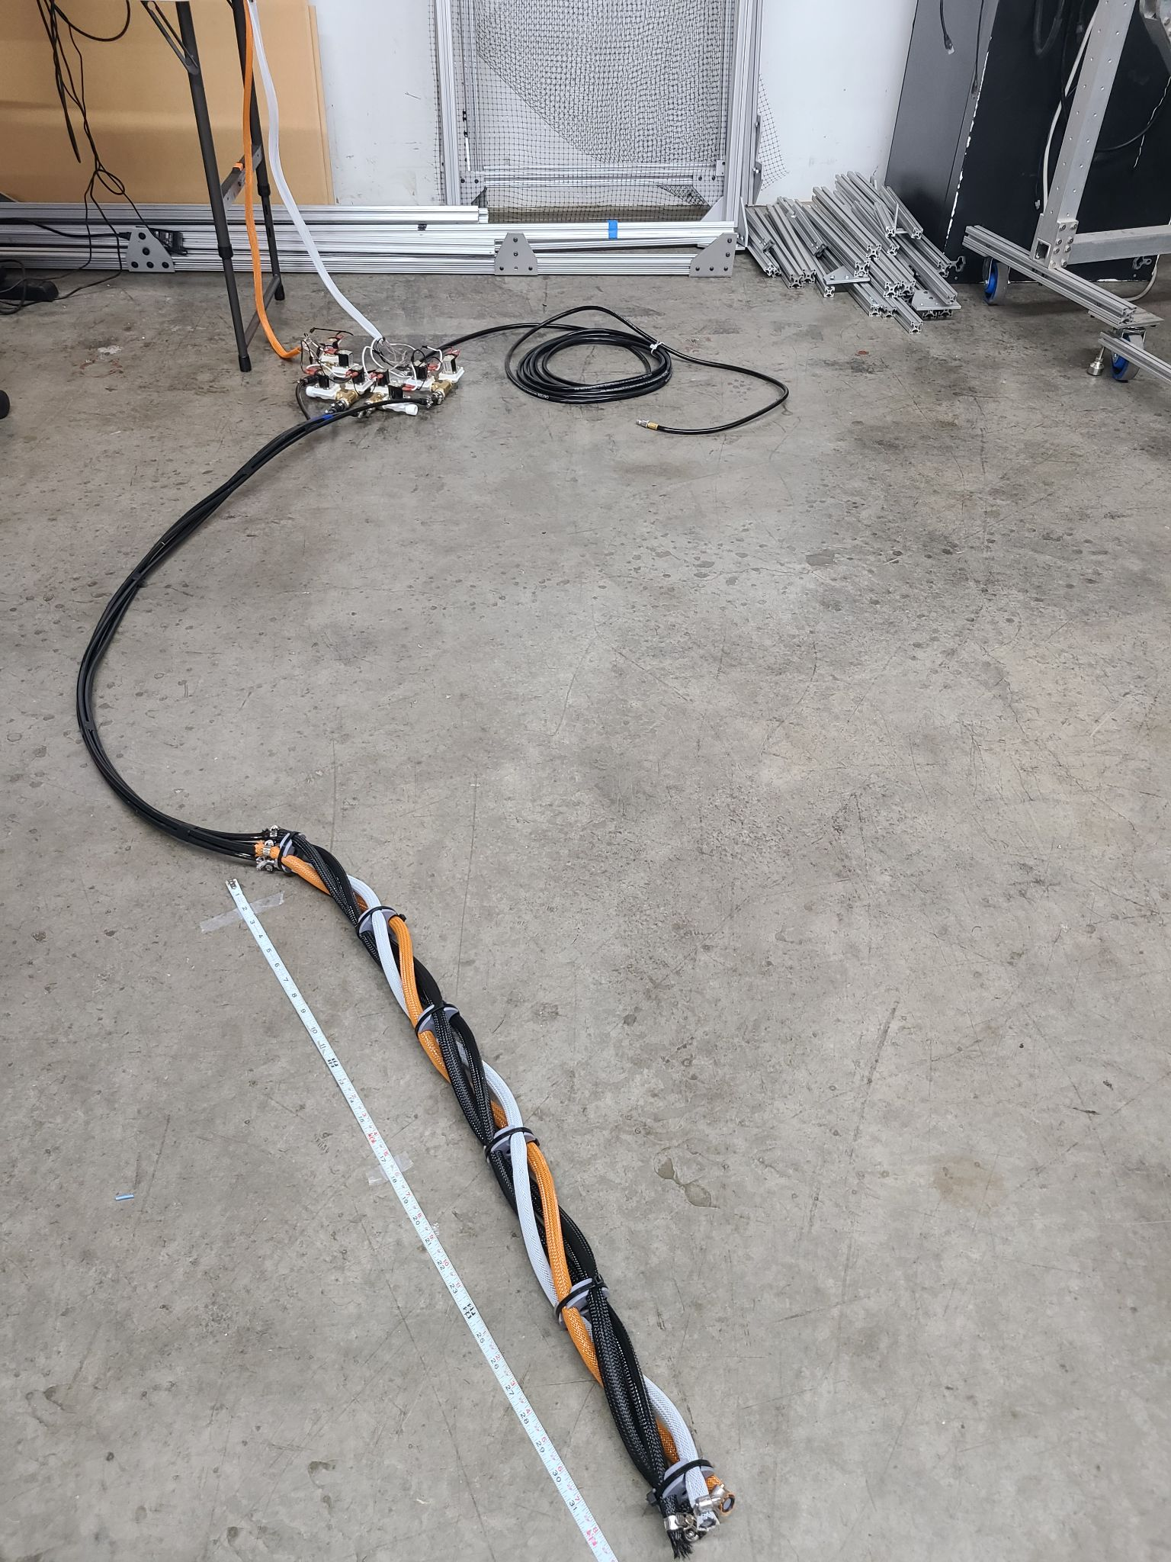
Flow Control and Airlines
Goal: Determine best flow rate and airline for the snake to use for future tests
Tested flow rates with 3D printed inserts
Tested stiff and flexible airlines
Selection: 0.1” inner diameter inserts and flexible airline
Overall setup

Slide 8
Sidewinding Control Schemes
Sequential
Actuator 1
Actuator 2
Actuator 3
Actuator 4
Inflation period | 0-1 | 1-2 | 2-3 | 3-4
Goal: Determine a control scheme that creates sidewinding motion to use for future tests
Tested sequential and concurrent cycles

Slide 9
Sidewinding Control Schemes
Sequential
Actuator 1
Actuator 2
Actuator 3
Actuator 4
Inflation period | 0-1 | 1-2 | 2-3 | 3-4
Concurrent
Actuator 1
Actuator 2
Actuator 3
Actuator 4
Inflation period | 0-0.5 | 0.5-1 | 1-1.5 | 1.5-2
Goal: Determine a control scheme that creates sidewinding motion to use for future tests
Tested sequential and concurrent cycles

Slide 10

Sidewinding Control Schemes
Concurrent control scheme created sidewinding motion
Sequential control scheme moved sideways but the motion wasn’t quite sidewinding
Sequential takes twice as long

Slide 11
Sidewinding Control Schemes
 | Head Displacement (in) | Tail Displacement (in) | Tail to Head Ratio
Concurrent | 25.38 | 8.26 | 0.33
Sequential | 23.99 | 10.38 | 0.43
Overall displacement was roughly the same
Concurrent moved better and faster
Selection: Concurrent control scheme

Slide 12
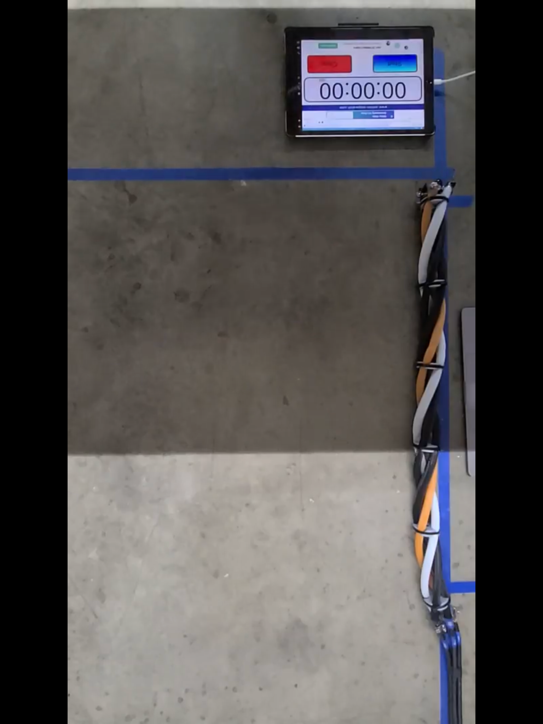
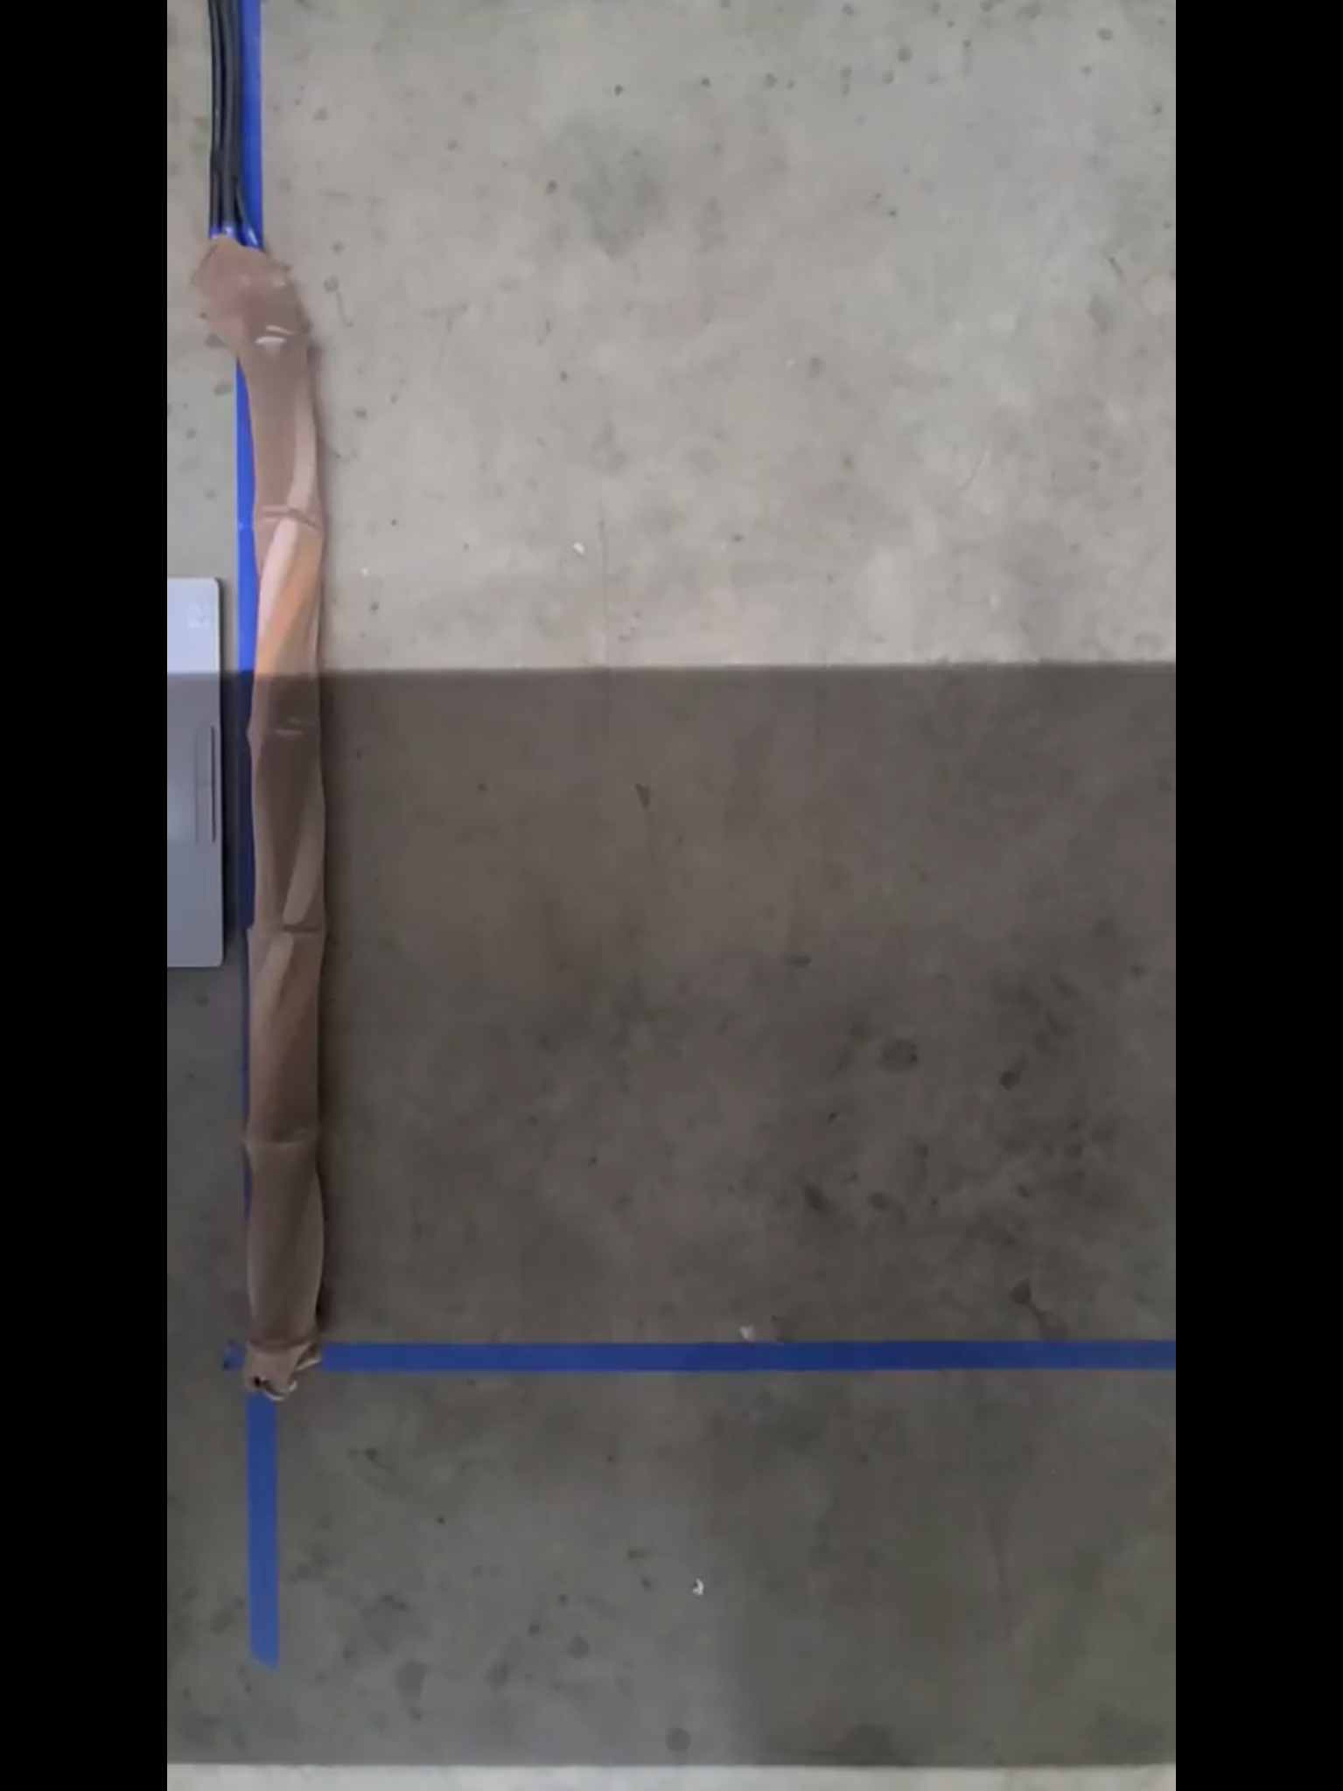
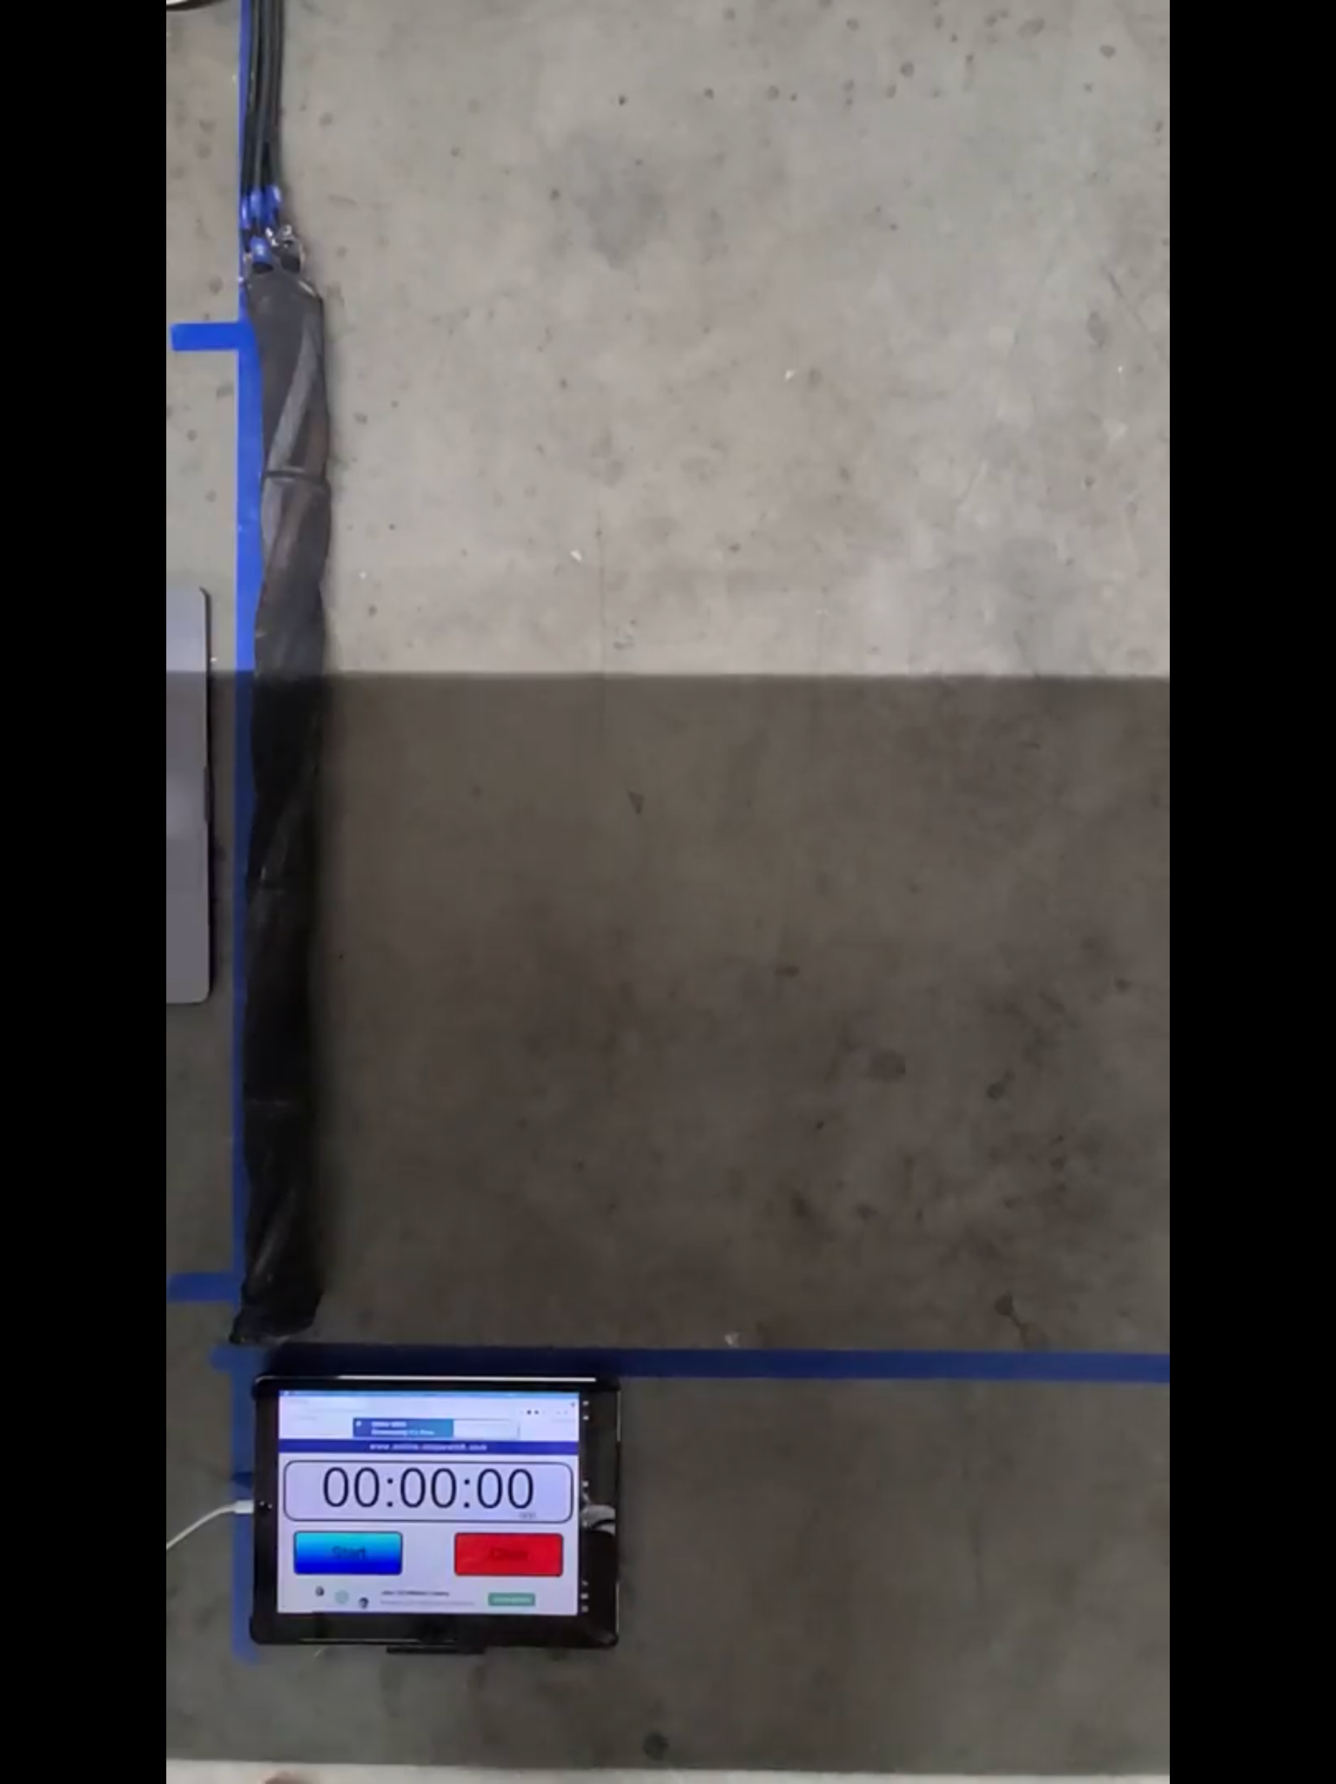
Material Tests
Goal: Understand how the sleeving material affects the movement
Difficult to compare because tests were done on different days
Materials tested (L-R):
No sleeving
Plain sleeving
Anti-slip spray coated sleeving

Slide 13
Material Tests
Terrain: Concrete |  | Head Disp. (in) | Tail Disp. (in) | Ratio
Day 1 | No Sleeving | 23.99 | 10.38 | 0.43
 | Plain Sleeving | 26.26 | 7.34 | 0.28
Day 2 | No Sleeving | 26.38 | 7.65 | 0.29
 | Spray Sleeving | 21.84 | 11.27 | 0.52
No clear better material between no sleeving and plain sleeving
The better material changes depending on the terrain and the metric
Anti-slip spray coated sleeving resulted in ratios closest to 1

Slide 14
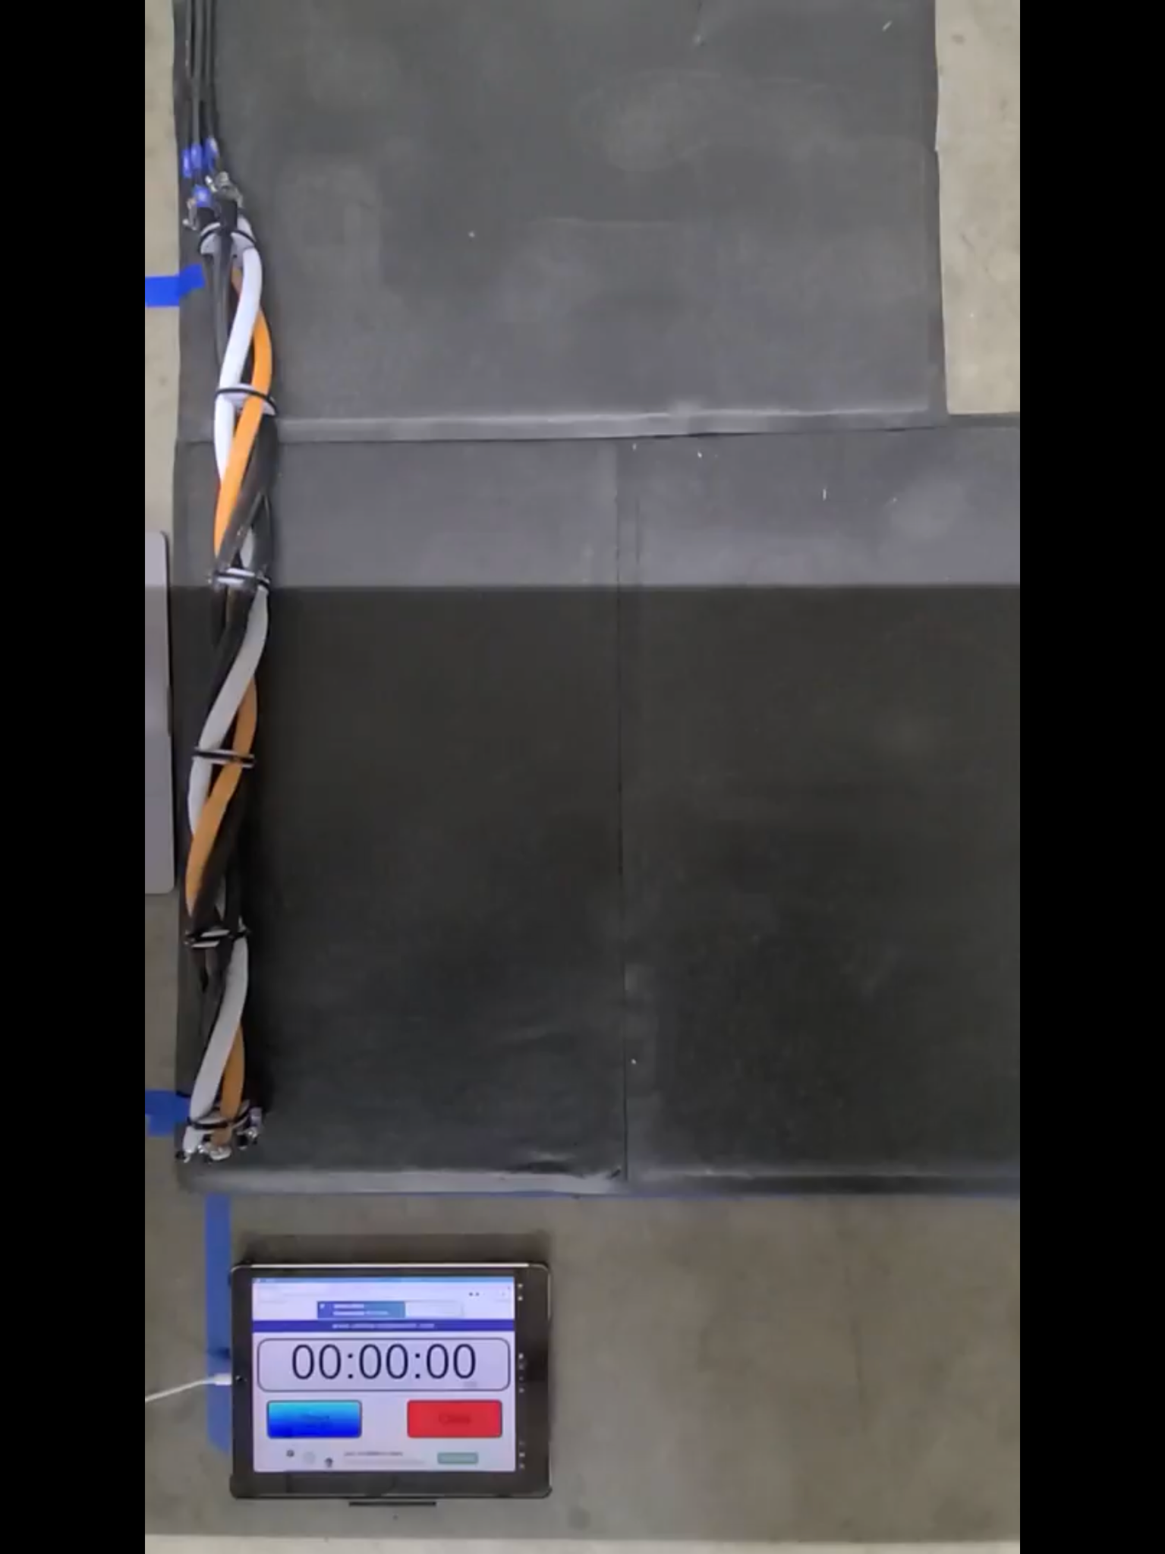
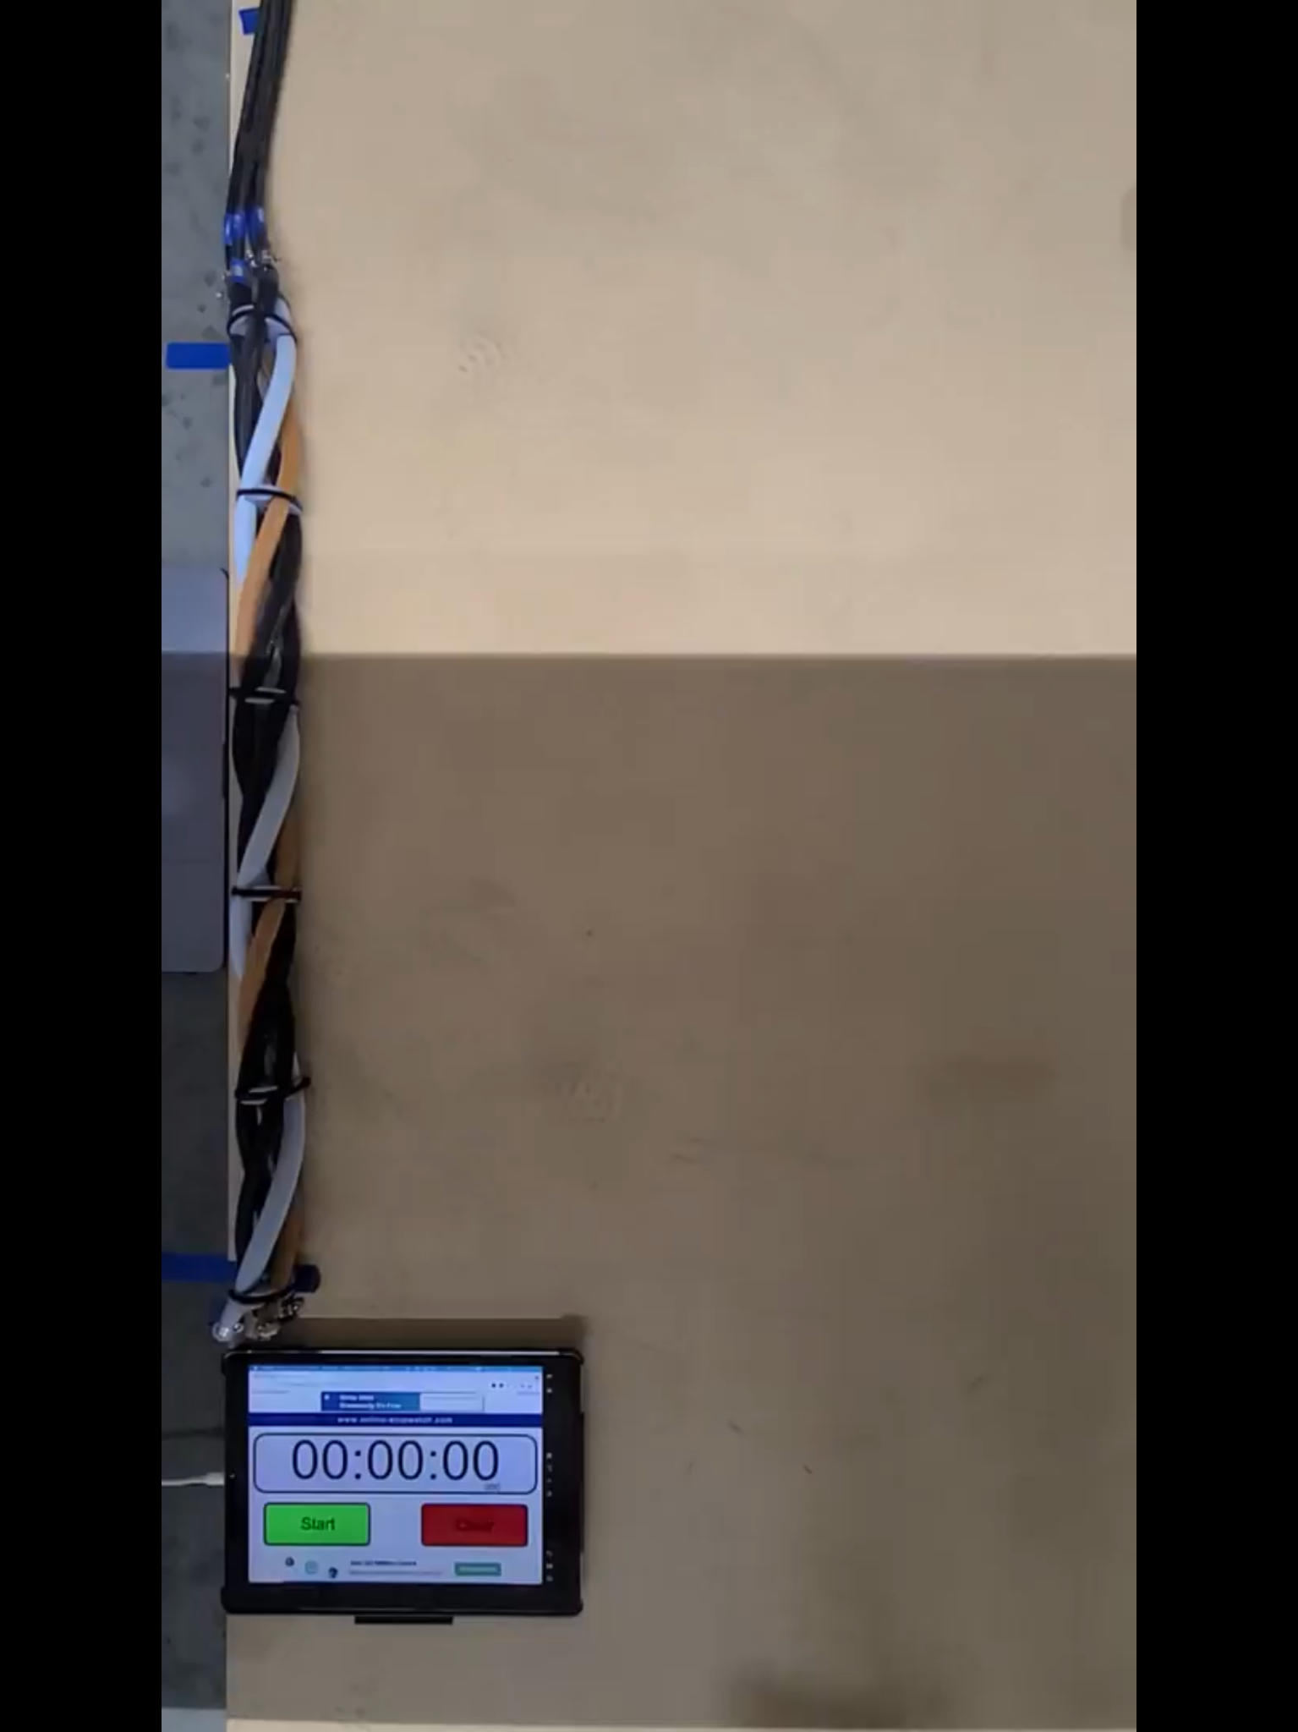
Terrain Tests
Goal: Understand how the terrain affects the movement
Materials tested (L-R):
Concrete
Rubber Mat
MDF
Experimented with a textured rubber mat but the snake was getting caught so we stopped using it

Slide 15
Terrain Tests
Material: No Sleeving | Head Disp. (in) | Tail Disp. (in) | Ratio
Concrete | 26.38 | 7.65 | 0.29
Rubber Mat | 21.55 | 8.68 | 0.40
MDF | 25.39 | 8.43 | 0.33
No clear best terrain across all metrics
The best terrain for each metric changes based on the sleeving material
None of the materials have significantly affected snake movement

Slide 16
Forward Movement
Goal: Determine control scheme(s) that allow the snake to move forward
Qualitatively evaluated multiple control schemes
Opposing pairs
Top and bottom pairs
Left and right pairs
Pair 1
Pair 2
Inflation period | 0-1 | 1-2
Notes:
Talk about wanting to investigate other types of movement since we have little understanding of this snake model

Slide 17
Forward Movement
Best control scheme: Top and bottom pairs
Always moved forward
Occasionally moved sideways
Other control schemes did not move forwards

Slide 18
Forward Movement
Works as a basic proof of concept
Overall moves forward and sometimes moves sideways
Airline position affects the movement and can cause sideways motion

Slide 19
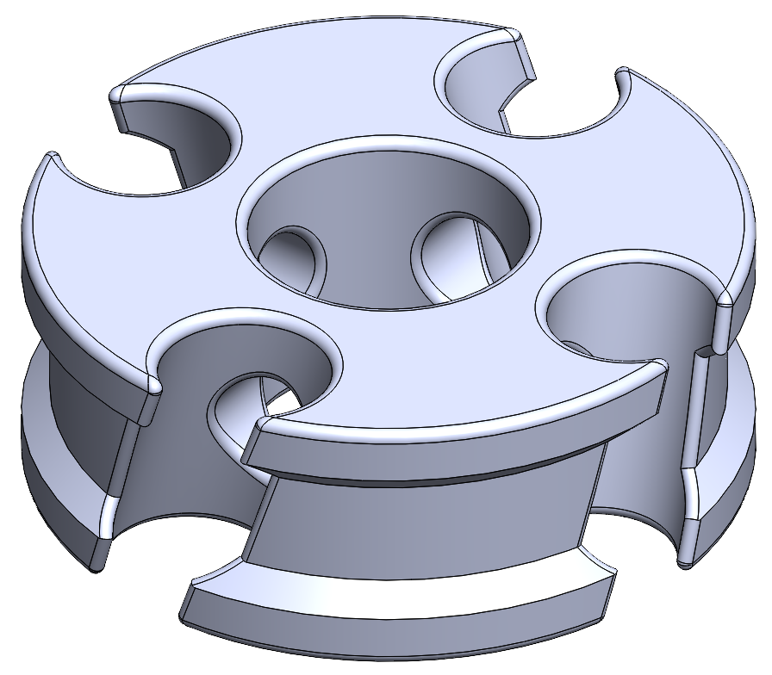
Small Snake
Goal: Verify previous results with a snake with smaller tube and helix diameters
Braces have been designed and are being 3D printed
Testing has not begun

Slide 20
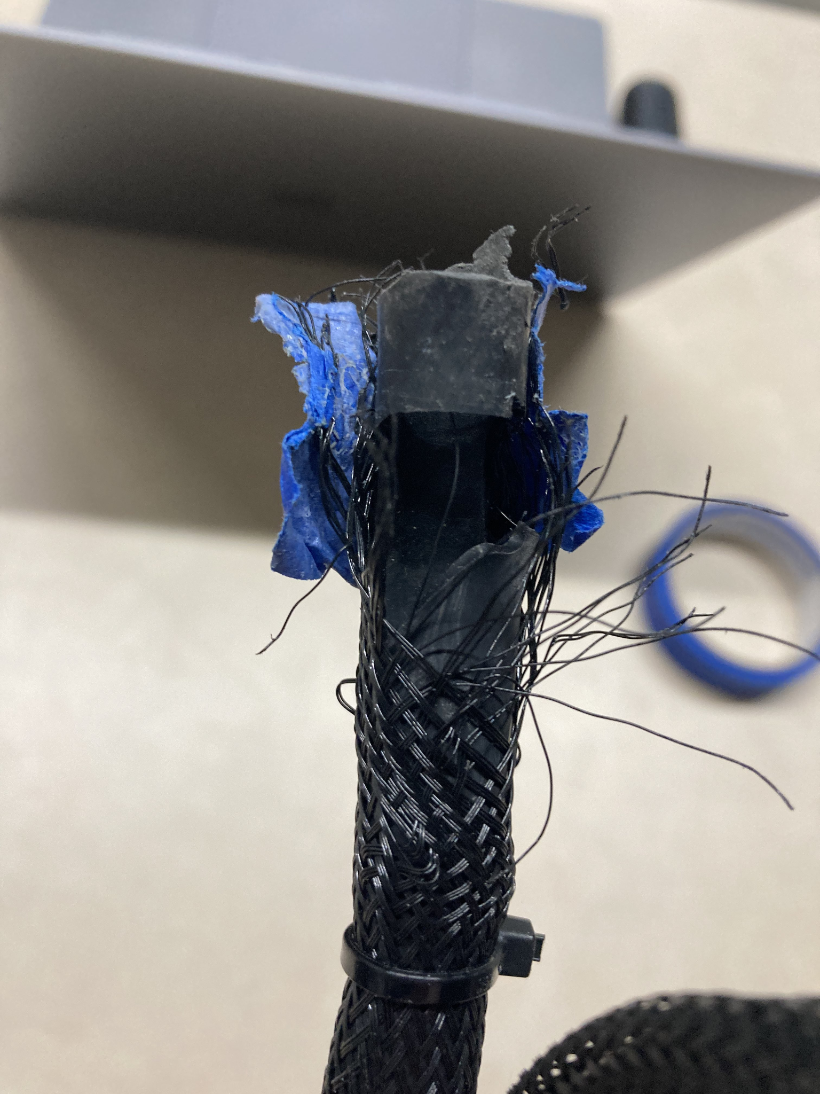
Challenges
Airlines caused variation in testing results
Exploded McKibben tubes that had to be replaced
Broke a solenoid which held back the testing process
Notes:
Airlines -> The same test performed on different days would result in different amounts of snake displacement

Slide 21
Contributions
Proved that we can create sidewinding motion with a McKibben actuators arranged helically on a soft, snake robot
Provided data on the effects of flow rate, material, and terrain on the snake movement
Identified control schemes for other motions that can be explored in the future

Slide 22
Future Work
Designing new iterations of the snake
Evaluating the effects of:
Alternative control schemes (ex: reversing the concurrent motion)
Airlines on the snake movement
Different sizes for the McKibben tubes and helix parameters
More varying terrain (granular media or slopes)
Anisotropic friction
Notes:
Friction that changes depending on the direction

Slide 23
Acknowledgements
I would like to thank Liv Dawes for being my undergraduate partner in this REU program.
I would like to thank Farhan Rozaidi for being my graduate student mentor.
I would like to thank Dr. Ross L. Hatton for being my faculty mentor.
I would like to thank the Idaho National Laboratory and National Science Foundation for funding for this project and the REU program.

Slide 24
Questions?

